Slide 1
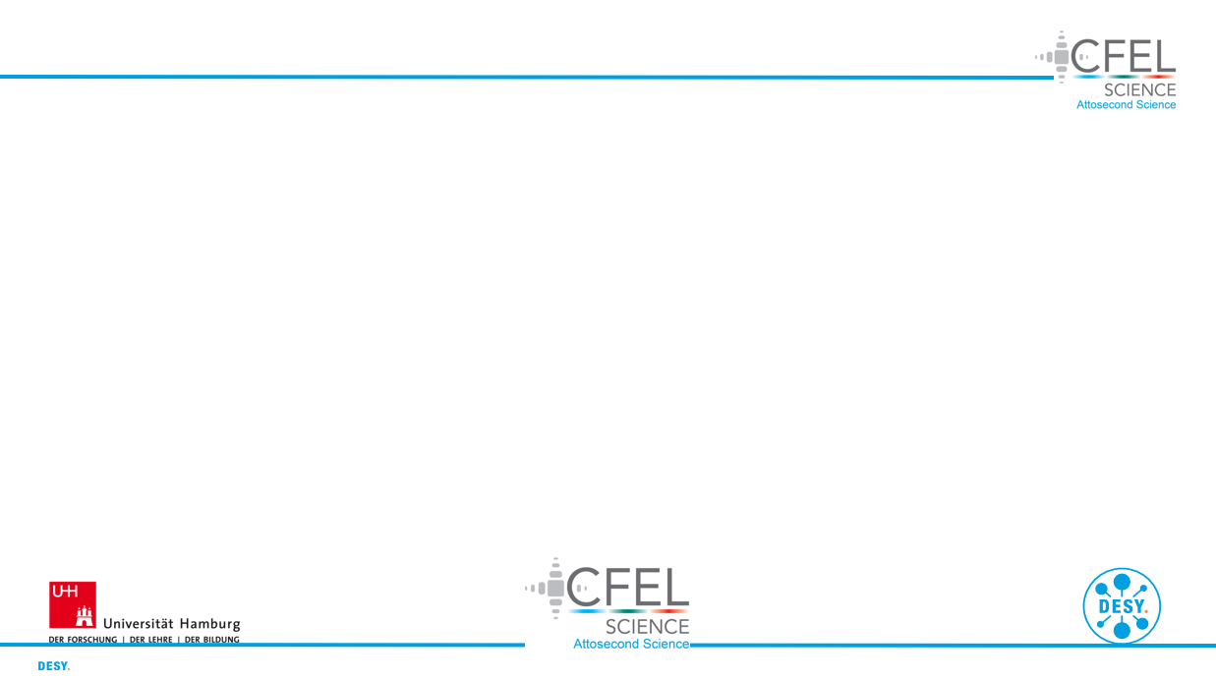
Modelling of nonlinear light up-conversion from intense femtosecond laser pulses
DESY Summer Student Programme 2023
Project Presentation
Group: CFEL-ATTO
Supervisor: Josina Hahne
David Amorim (University of Glasgow)

Slide 2
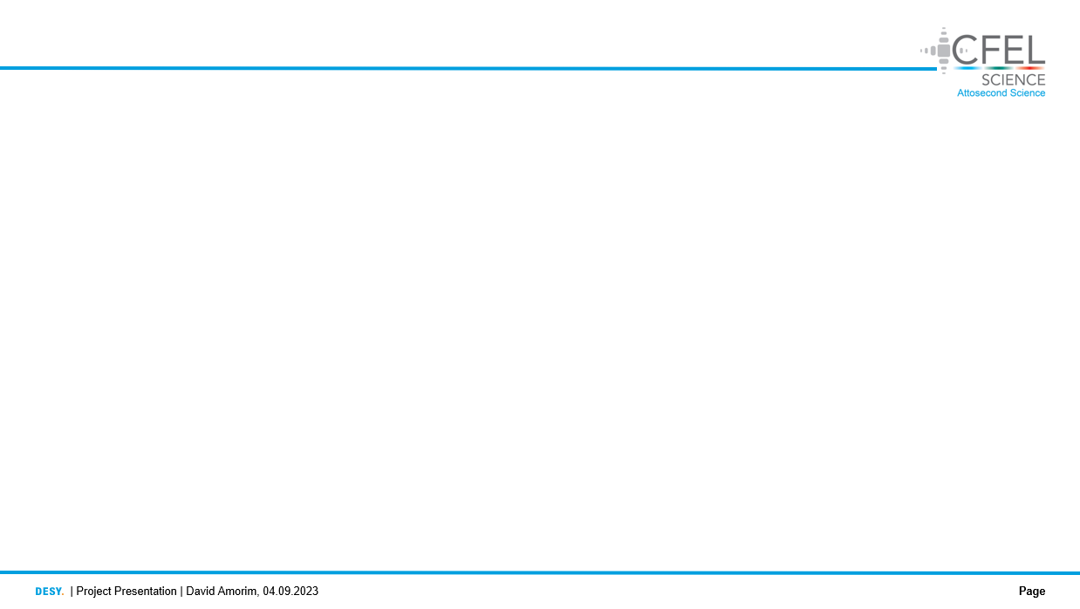
Overview
Motivation
Background
Simulation inputs
Simulation output
Comparison with experiment
Self-steepening
Effects of chirp
Effects of CEP
Gas comparisons
Gas cell comparisons
Discussion & conclusion
Acknowledgments & references

Slide 3
1. Motivation
The CFEL-ATTO group uses THG of few-femtosecond IR laser pulses in a gas cell to produce ultrashort UV pulses
The aim of this project was to produce simulations of the THG process to:
Reproduce the experimental conditions in the gas
Study the effects dominating the THG process
Investigate how changes to different input parameters affect the UV pulses
Compare the new gas chip to the old (2019) cell
Fig. X: the old and new gas cell

Slide 4

2. Background
The simulations were produced using the Luna.jl package [1]
Luna numerically solves the unidirectional pulse propagation equation (UPPE) for a pulse travelling in the z-direction:
$E\left(ω, k_{⊥},z\right)$ is the reciprocal-space electric field amplitude in the frequency domain
$k_{⊥}$ is the transverse spatial frequency vector
$\hat{L}\left(ω,z\right)=i \left(β\left(ω, z\right)−\frac{ω}{v}\right)−\frac{1}{2}α(ω,z)$ is a linear operator describing dispersion and absorption
$N$ is a normalisation factor
$P^{NL}\left(ω, k_{⊥},z\right)$ is the reciprocal-space nonlinear polarisation response in the frequency domain
A Hankel transform is used to transform into reciprocal space, assuming radial symmetry
$$\frac{∂}{∂z}E\left(ω, k_{⊥},z\right)=\hat{L}\left(ω,z\right)E\left(ω, k_{⊥},z\right)+\frac{i ω}{N}P^{NL}\left(ω, k_{⊥},z\right)$$
(1)

Slide 5

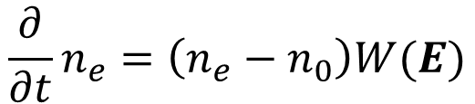
2. Background
The UPPE is derived directly from Maxwell’s Equations without using a slowly-varying envelope approximation [2]
The nonlinear polarisation response considers the Kerr effect as well as photo-ionisation: $P^{NL}=P^{Kerr}+P^{ion}$, with
where $I_{p}$ is the ionisation potential, $n_{e}$ is the number of free electrons, $n_{0}$ is the initial number of neutral atoms, $W(E)$ is the ionisation rate and all other symbols have their usual meaning
$$P^{Kerr}\left(t, r_{⊥},z\right)=χ^{\left(3\right)}{\left[E(t, r_{⊥},z)\right]}^{3}$$
(2)
$${\frac{∂}{∂t} P}^{ion}\left(t, r_{⊥}, z\right)=\frac{I_{p}}{E(t, r_{⊥},z)}\frac{∂n_{e}}{∂t}+\frac{e^{2}}{m_{e}^{2}}\int_{−∞ }^{t}{n_{e}\left(t^{′}\right)E(t^{′}, r_{⊥},z)dt′}$$
(3)
$$\frac{∂}{∂t}n_{e}=\left(n_{e}−n_{0}\right)W(E)$$
(4)

Slide 6
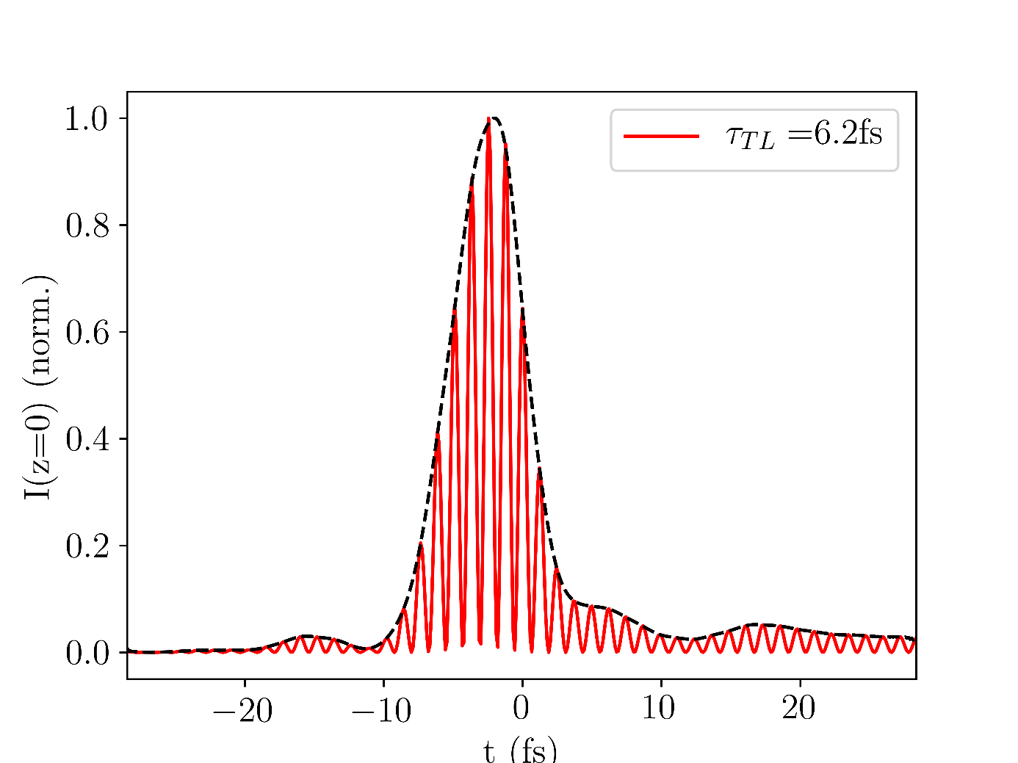
3. Simulation inputs
The simulation input was based on measured data, as far as possible:
Time-intensity data of the IR input beam (based on FROG) was fed in
The spatial profile of the input beam was assumed to be a Gaussian with beam waist 65μm (based on measurement)
The gas density profile was based on COMSOL simulations of the gas cell (carried out by Josina Hahne and Agata Azzolin)
A variety of input parameters were considered (e.g. chirp, CEP,…)
Fig. X: IR input pulse in the time domain

Slide 7
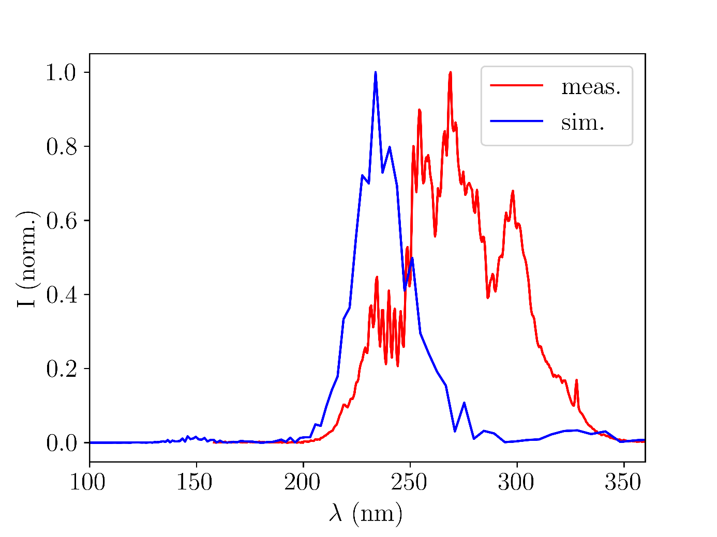
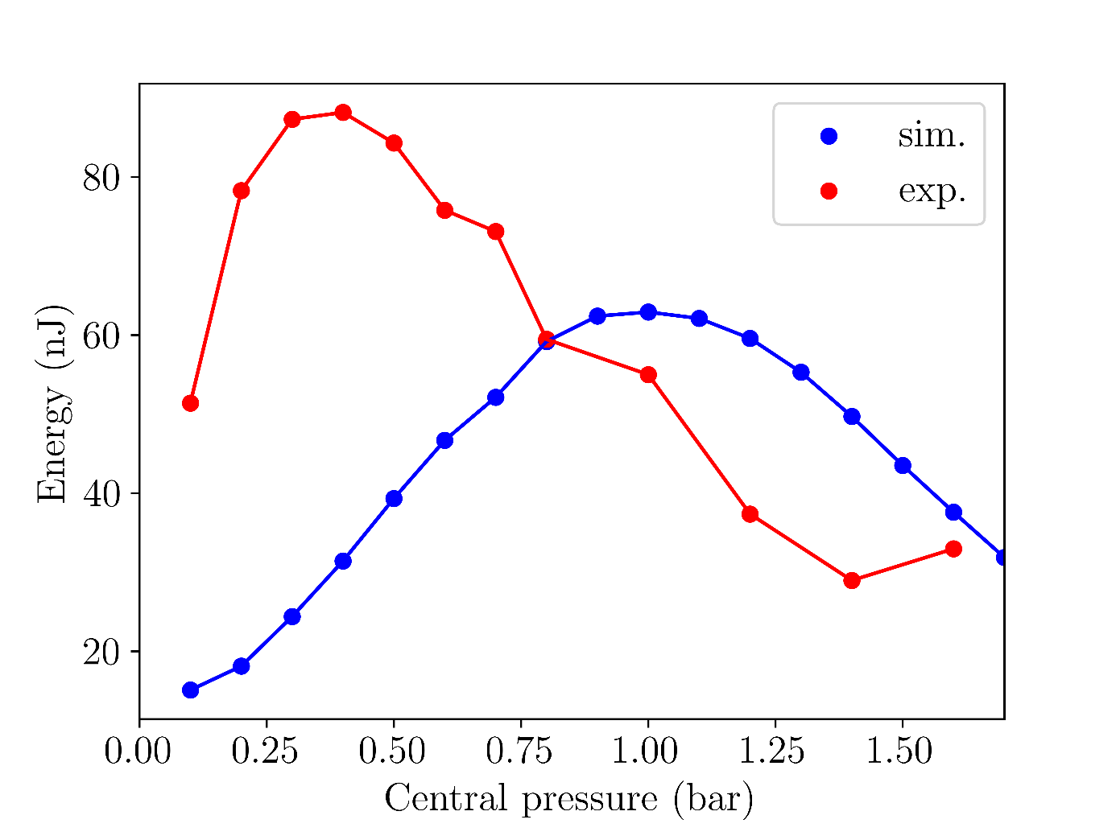
4.I Comparison with experiment
The simulated UV spectra and energies agree well with experiment:
Fig. X: UV output spectra for Argon with 150mW
input beam power and 0.4bar central pressure
Fig. X: UV output energies for Argon with 150mW
input beam power

Slide 8
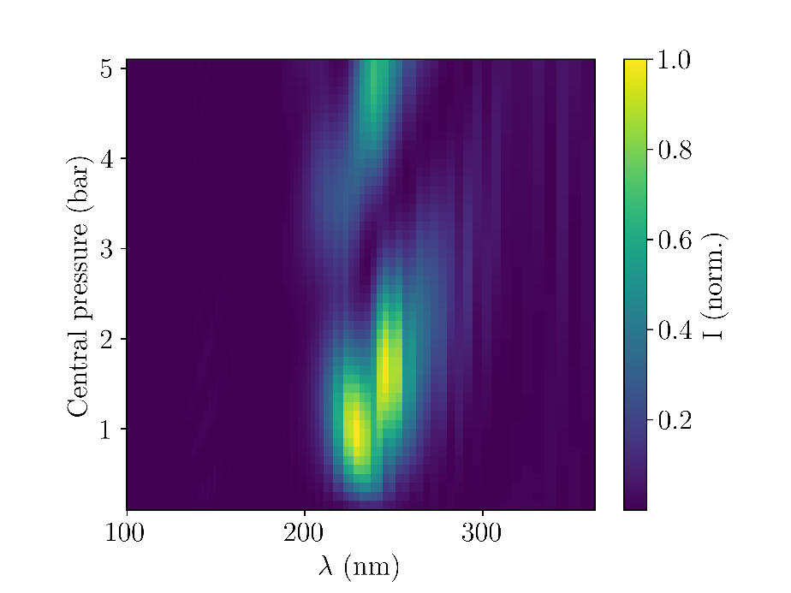
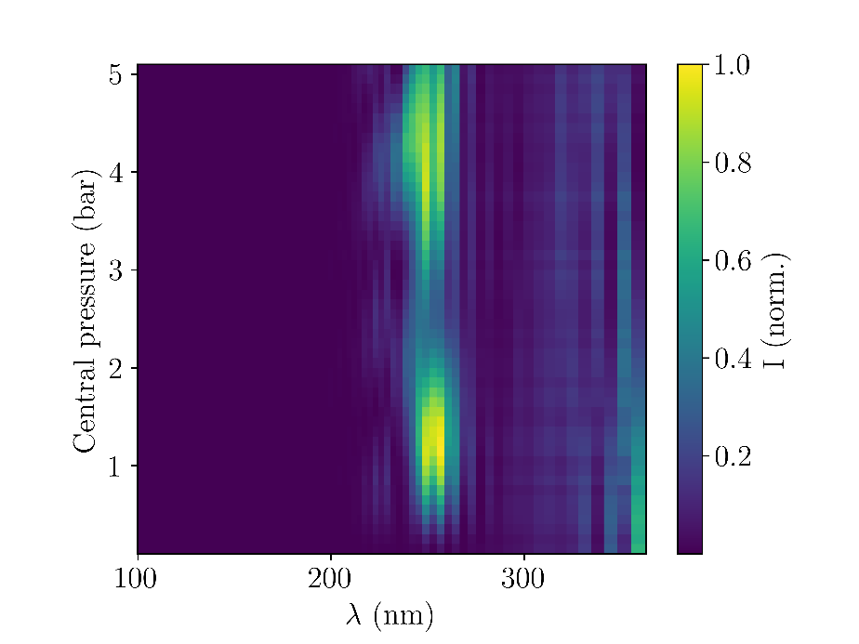
4.I Comparison with experiment
(a) simulated
(b) measured
Fig. X: UV output spectral pressure scan map (Argon, 150mW)

Slide 9
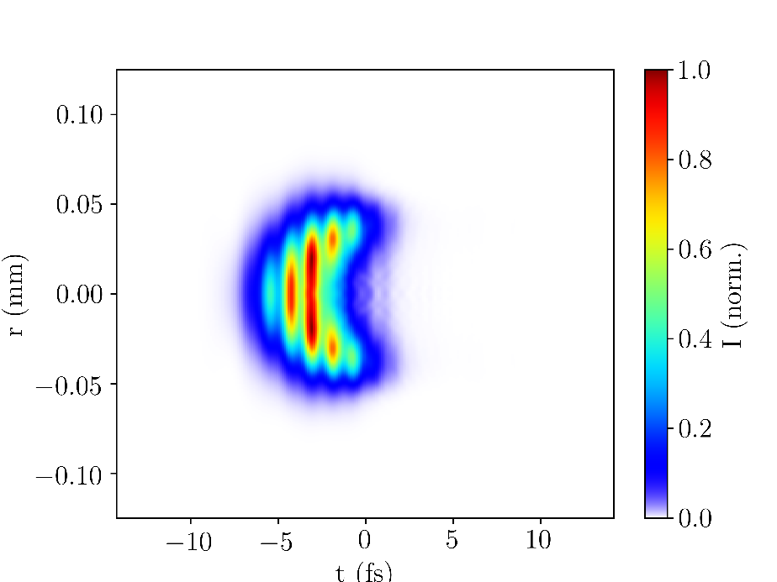
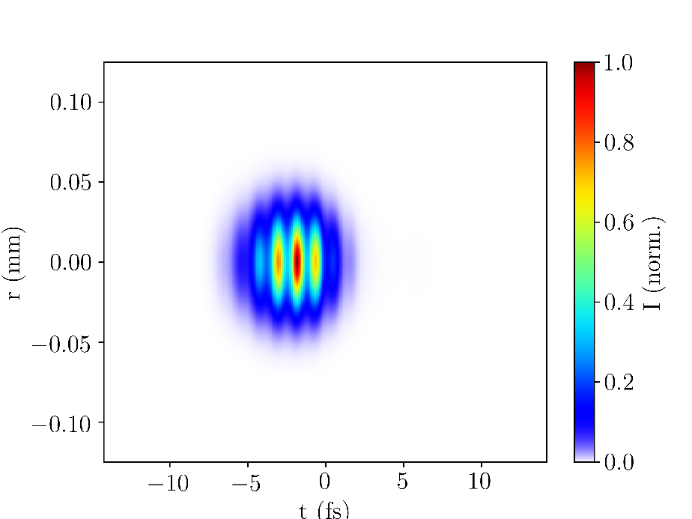
4.II Self-steepening
The simulations could demonstrate leading-edge self-steepening of the UV pulses
This adds to spectral broadening and pulse compression
Self-steepening seems to be caused by ionisation
These results agree with the literature [3]
(a) with ionisation
(b) without ionisation
Fig. X: UV output beam profile with and without ionisation (Argon, 150mW, 0.4bar)

Slide 10
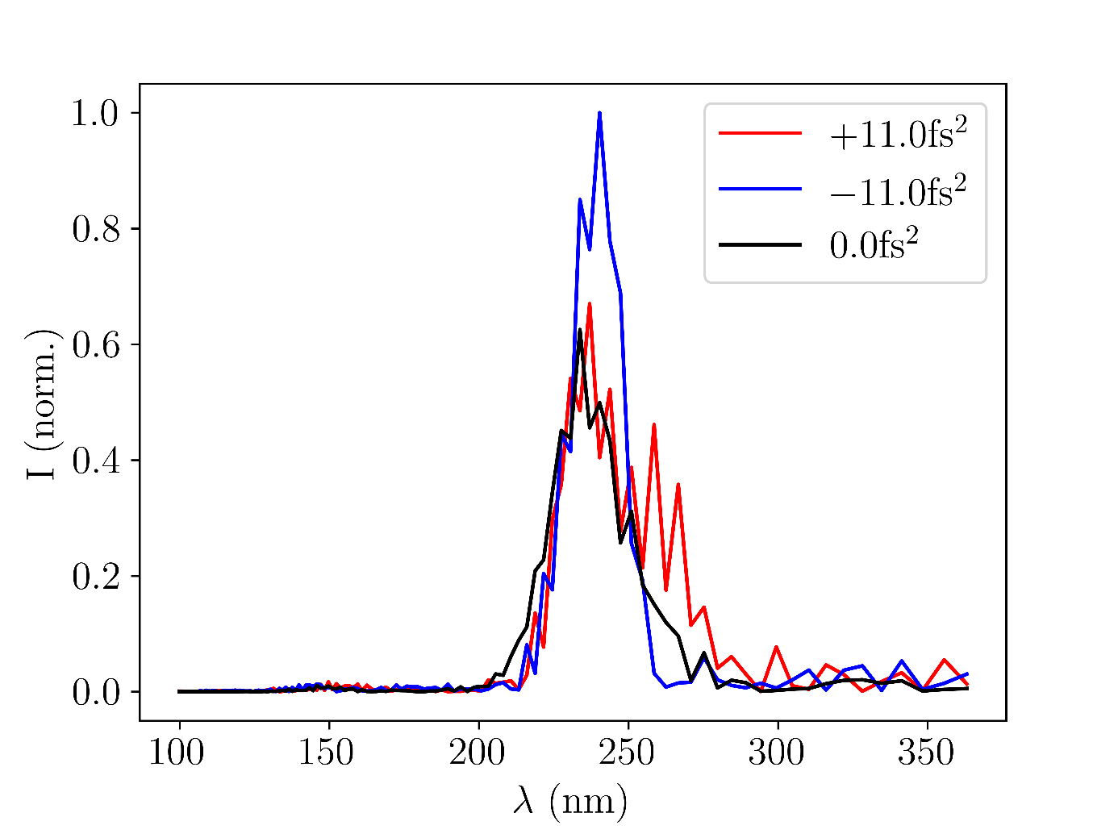

4.III Effects of chirp
The simulations were used to investigate the effects of chirp (GVD) on the UV output spectra
The chosen GVD values of $±$11.0fs² correspond to an input pulse stretched from 6.2fs to 9.Xfs
Negative chirp increases UV intensity without introducing significant spectral broadening
Positive chirp results in a broadened spectrum (towards the blue end)
Fig. X: UV output spectra for different GVD values of the input beam (Argon, 150mW, 0.4bar)

Slide 11
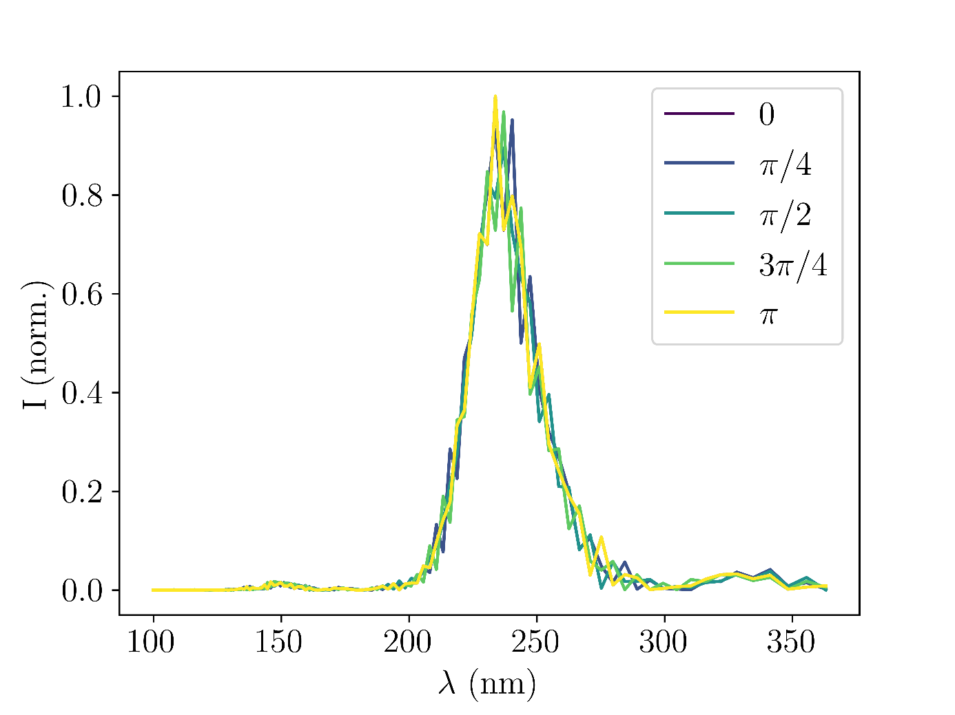
4.IV Effects of CEP
Fig. X: UV output spectra for different CEP values of the input beam (Argon, 150mW, 0.4bar)

Slide 12
4.V Gas comparisons

Slide 13
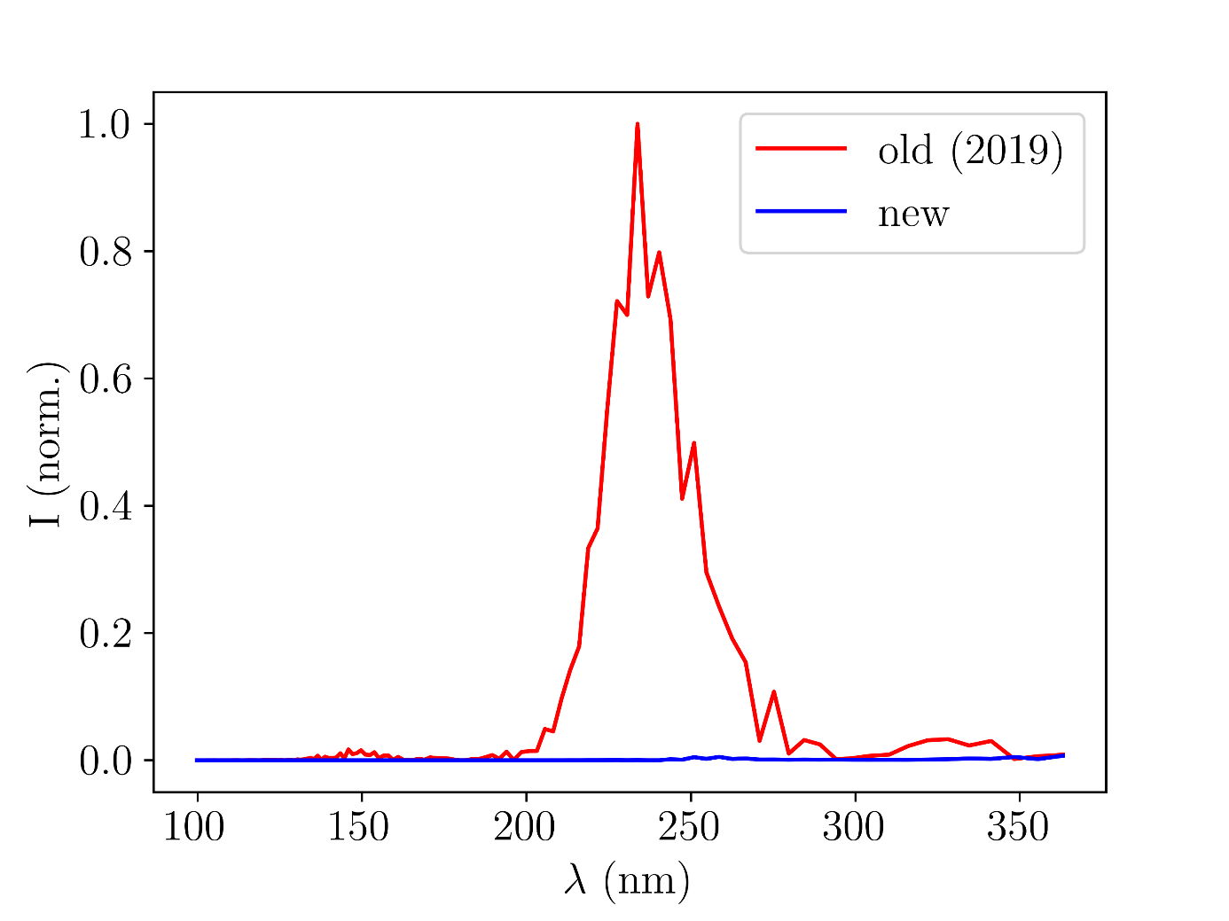
4.VI Comparing the gas cells
Fig. X: Simulated UV output produced with Argon at 150mW and 0.4bar comparing the new and old gas cells

Slide 14
5. Discussion & conclusion
The THG simulations resulted in some promising outputs
Agreement with experiment and literature
Some of the figures shown here will be used in the manuscript for JPhys Photonics being prepared
There is significant room for further improvements
Base the spatial profile of the input beam on measured data (this requires dropping the assumption of radial symmetry)
Take into account that the beam channel radius changes throughout the chip
Further improve the COMSOL simulations
With additional expansions, the simulation code could serve as a basis to back up future experiments with theory

Slide 15
6. Acknowledgments & references
Acknowledgments
Thank you to Josina Hahne, Vincent Wanie, and Agata Azzolin for their help with the project as well as to the rest of the CFEL-ATTO team for being so welcoming and friendly.
References
[1] C. Brahms and J. C. Travers, “Luna.jl,” (2023); https://doi.org/10.5281/zenodo.8242646
[2] M. Kolesik and J. V. Moloney, “Nonlinear optical pulse propagation simulation: From Maxwell’s to unidirectional equations,” Phys. Rev. E 70, 036 604 (2004)
[3] F. Reiter, U. Graf, et al. “Route to Attosecond Nonlinear Spectroscopy,” Phys. Rev. Lett. 105, 243 902 (2010)

